Slide 1
Smithgall Woods Park Website
Project Updates
MIST7590 – MIT Project I
Andrea Castresana
Jennifer Lazo
Alexander Couch
Clark Williams
Eliseo Santos
October 11, 2017

Slide 2
Overview
Accomplishments to Date
Use Case Diagrams
Workflow Diagrams
Data Models
Way Ahead

Slide 3
Accomplishments to Date
Completed systems analysis of the website
Identified malicious injected code & disabled it temporarily
Gathered initial user requirements & prioritized them from high to low
Developed prioritized requirements into proposed system requirements
Created home page mockups for Mobile & PC views
Built simple prototype of site home page in HTML
Began developing the Project Charter
Provided project plan & list of questions to Mr. Pease (client)

Slide 4
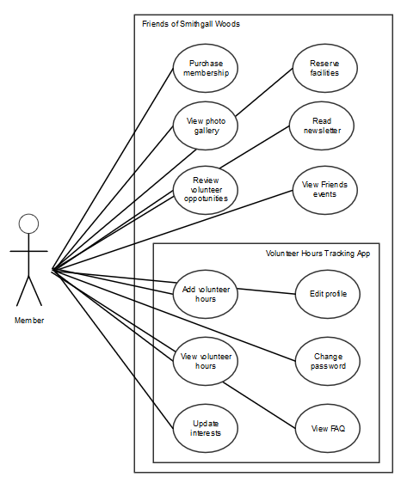
Friends Volunteer Use Cases
Notes:
The person who performs volunteer work for Smithgall Woods (SGW) is a Friends Chapter member. All other volunteers that are NOT Friends Chapter members are tracked through the Georgia State Park website.

Slide 5
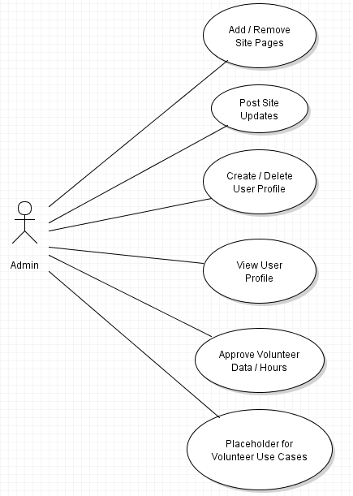
Admin Use Cases
Notes:
The last bubble “Placeholder for Volunteer Use Cases” is only used in this diagram to indicate some use cases from the Volunteer actor.

Slide 6
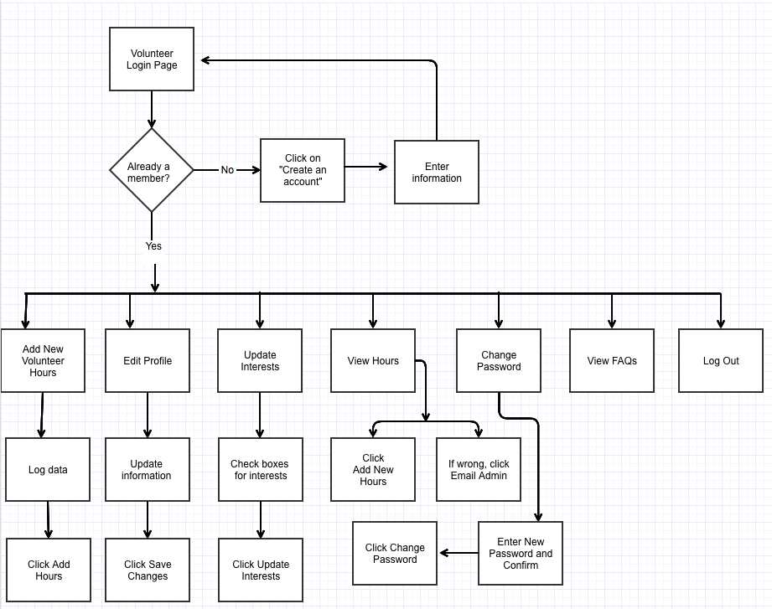
Friends Volunteer Workflow
Notes:
This Friends Volunteer workflow describes the existing Friends Volunteer Log process.

Slide 7
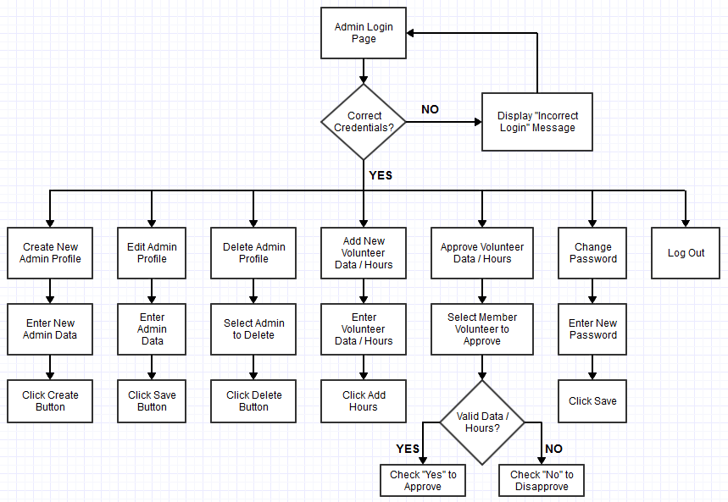
Admin Workflow
Notes:
This Admin Workflow is based on the proposed user/system requirements. A separate login page for Admin will be developed, and an Admin/Password pair will be set up initially in the MySQL “admin_login” table. Then, the Admin must log in first to create user accounts with admin privileges.

Slide 8
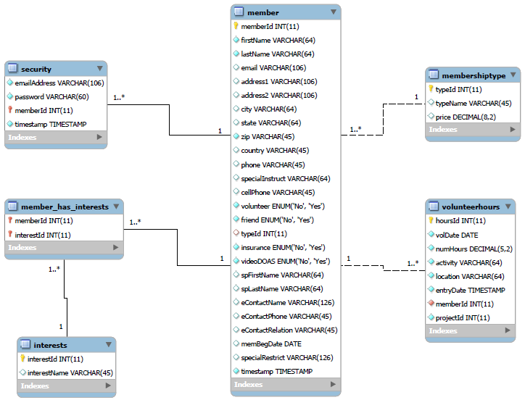
Existing Data Model
Notes:
Based on the team’s initial assessment of the SGW’s existing databases, only six tables were originally defined as shown here with one-to-many relationship. The rest of the tables in the databases were defined without references or relationships.

Slide 9
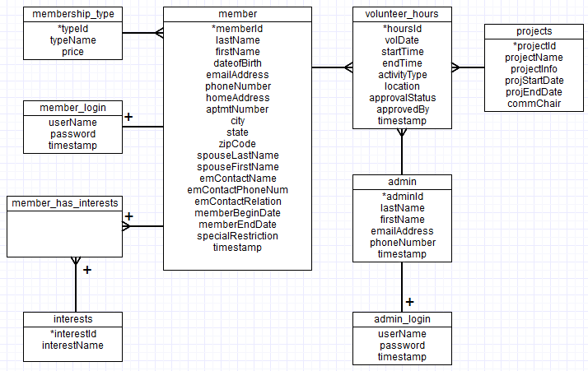
Suggested Data Model
Notes:
This data model is based on the proposed user/system requirements. The “admin” and “projects” tables are added and related to the “volunteer_hours” table with one-to-many relationship as shown here. In the “volunteer_hours” table, two attributes (approvalStatus and approvedBy) are also added for Admin validation of volunteer data.

Slide 10
Way Ahead
Continue working on Project Charter
Follow up with Mr. Pease to schedule initial project discussion
Email request for written feedback/response to 15 questions
Update logical models based on discussion with client
Continue building the website prototype

Slide 11
Questions

Slide 12
BACKUPS

Slide 13
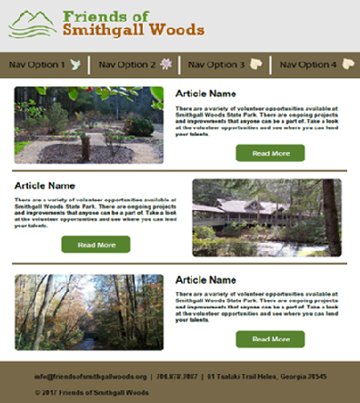
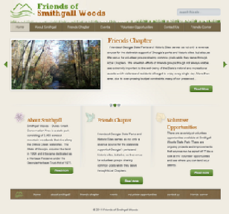
Home Page Mockup (Desktop Version)
Proposed Home Page
Current Home Page

Slide 14
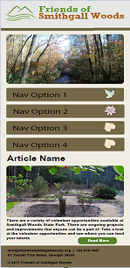
Home Page Mockup (Mobile Version)

